Slide 1

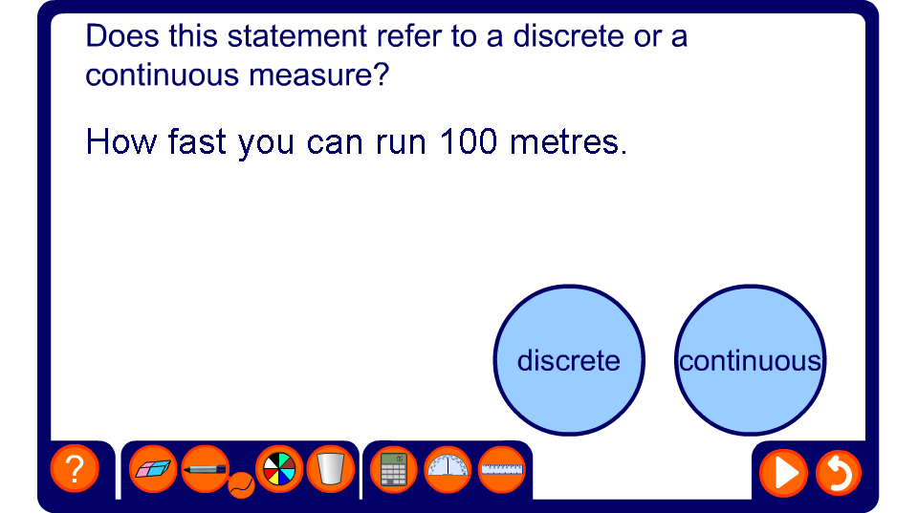


Discrete or continuous?
Notes:
In this activity, pupils need to decide whether the data described is discrete or continuous. They could write a D or a C on mini whiteboard; or to make learning kinaesthetic (active), get pupils to stand up if it’s discrete and sit down if continuous; or run to one side of the room.

